Slide 1
Two-Way Independent ANOVA (GLM 3)
Chapter 12

Slide 2
What is Two-Way Independent ANOVA?
Two Independent Variables
Two-way = 2 Independent variables
Three-way = 3 Independent variables
Different participants in all conditions.
Independent = ‘different participants’
Several Independent Variables is known as a factorial design

Slide 3
What is Two-Way Independent ANOVA?
Often people call these:
Two-way between subjects ANOVA
Indicates all the IVs are between
Two-way factorial ANOVA
Although that’s a bit redundant
Just Factorial ANOVA

Slide 4
Other ANOVAs
Two-way repeated measures ANOVA
Indicates all IVs are repeated
Two-way mixed ANOVA
Indicates 1 IV = between, 1 IV = repeated

Slide 5
How to Report ANOVA
The most informative way to talk about ANOVAs:
# of Levels X # of Levels
Type of ANOVA
Example:
2X2 Between subjects ANOVA

Slide 6
Benefit of Factorial Designs
We can look at how variables Interact.
Interactions
Show how the effects of one IV might depend on the effects of another
Are often more interesting than main effects.

Slide 7
Assumptions
Same as one-way ANOVAs
Accuracy, Missing, Outliers
Additivity (still only one DV)
Normal
Linear
Homogeneity (Levene’s Test)
Homoscedasticity

Slide 8
Back to levels/conditions
Remember:
IVs: each individual IV has levels.
The combinations of levels are the conditions.
Interactions examine the conditions.
(across or down)

Slide 9
Example
IV: Gender of participant
Levels: Male/Female
IV: Sport attended
Levels: None, volleyball, football
DV: Satisfaction with athletics on campus

Slide 10
Draw Out

Slide 12
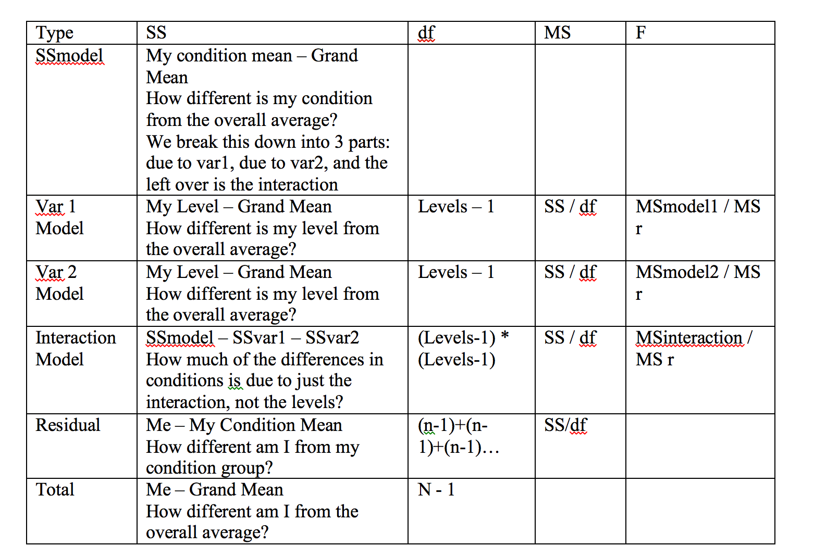

Slide 13
SS Total
Same as one-way ANOVA
Each person minus the grand mean
Dftotal = N – 1
Remember N = total sample size

Slide 14
SS Model
Remember that SS model =
My group mean (condition) – grand mean
But now we have several groups that I’m in – and this formula ignores that these conditions are structured by IV, so we are going to break this down by IV instead of pretending they are all the same IV.

Slide 15
SS A = SS gender
Same formula as SS model … but ignoring the other variable.
Level mean – grand mean
DF a = (k-1)
K = levels

Slide 16
SS B = SS sport
Same formula as SS model … but ignoring the other variable.
Level mean – grand mean
DF b = (k-1)

Slide 17
Marginal Means
These “level means” are considered marginal means.

Slide 18
SS AXB = interaction
DF AXB = Dfa X DFb

Slide 19
SS_{R} = error
This formula doesn’t change – average variance across groups.
Each participant – my condition mean
Notes:
The residual sum of squares is calculated in the same way as for one-way ANOVA and again represents individual differences in performance or the variance that can’t be explained by factors that were systematically manipulated. We saw in one-way ANOVA that the value is calculated by taking the squared error between each data point and its corresponding group mean. An alternative way to express this was as in equation 1 in the slide.
So, we use the individual variances of each group and multiply them by one less than the number of people within the group (n). We have the individual group variances in our original table of data (first page of this handout) and there were 8 people in each group (therefore, n = 8) and so the equation becomes the second equation on the slide.
The degrees of freedom for each group will be one less than the number of scores per group (i.e. 7). Therefore, if we add the sums of squares for each group, we get a total of 6 × 7 = 42.

Slide 21
How to run R
How to use the * operator
When you multiple the variables together you are creating the interaction and the lower order effects.
What do you mean lower order effects?
Interaction = Sport * Gender
Lower: Sport
Lower: Gender

Slide 22
How to run R
Levene’s Test
Since we are doing between subjects ANOVA, we still want to check homogeneity
Remember it’s in the car library.
leveneTest(Y ~ X*X, data = data, center = mean)
Run the anova:
Output = aov(Y ~ X*X, data = data)

Slide 23
How to run R
Warning: there are different types of ANOVA math.
The most common type is Type III sum of squares (what we are learning).
After much ado, you can still use the summary function:
summary(output)

Slide 24
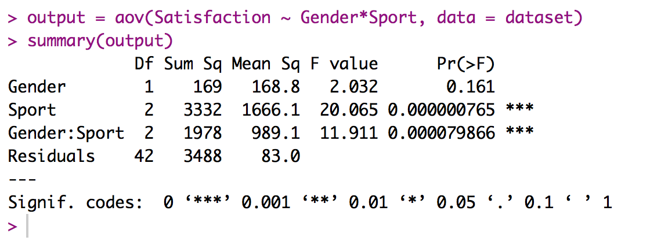
How to run R
Now we have three values oh no! What to do?!

Slide 25
How to run R
Write up the MAIN EFFECTS:
Gender F(1,42) = 2.03, p = .16
Sport F(2, 42) = 20.07, p < .001
Write up the INTERACTION:
Interaction F(2, 42) = 11.91, p < .001

Slide 26
How to run R
Effect sizes – what do I do now that we have three effects?
Most common: Partial eta squared for each omnibus F test
Or you can do partial omega squared as well

Slide 27
How to run R
Partial eta: Here the effects are estimated based on the effect and error together (different denominator)
ɳ_{p}² = SS_{model}/(SS_{error} + SS_{model})
Note that with one IV partial and total eta are the same, but with multiple IVs they are not.

Slide 28
How to run R
Write up the MAIN EFFECTS:
Gender F(1,42) = 2.03, p = .16, ɳ_{p}² = .05
Sport F(2, 42) = 20.07, p < .001, ɳ_{p}² = .49
Write up the INTERACTION:
Interaction F(2, 42) = 11.91, p < .001, ɳ_{p}² = .36

Slide 29

How to run R
Partial omega squared:
a = levels (a-1) = dfmodel
n = number of people in each level

Slide 30
How to run R
Graph the main effects (just to see what happened)
Graph the interaction (this picture is the one you generally report)

Slide 31
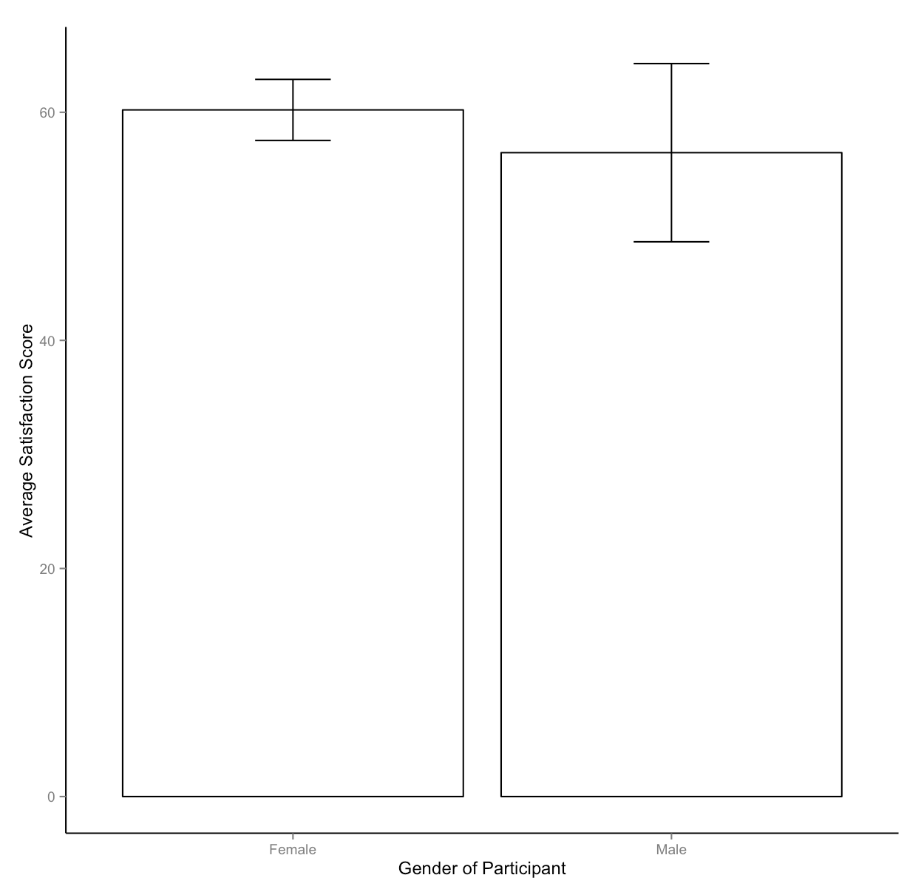

Slide 32
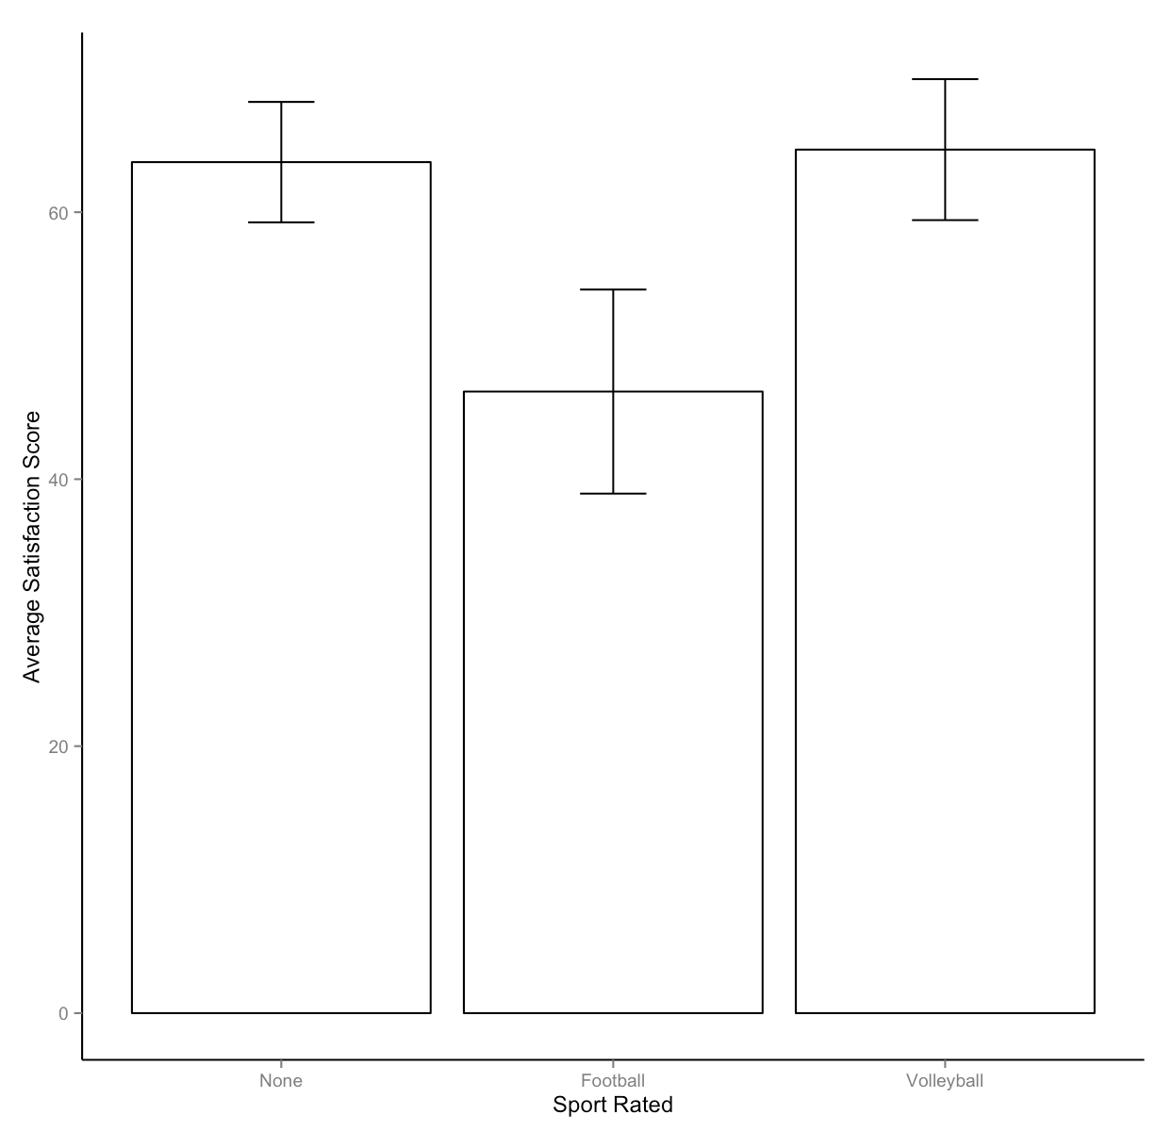

Slide 33
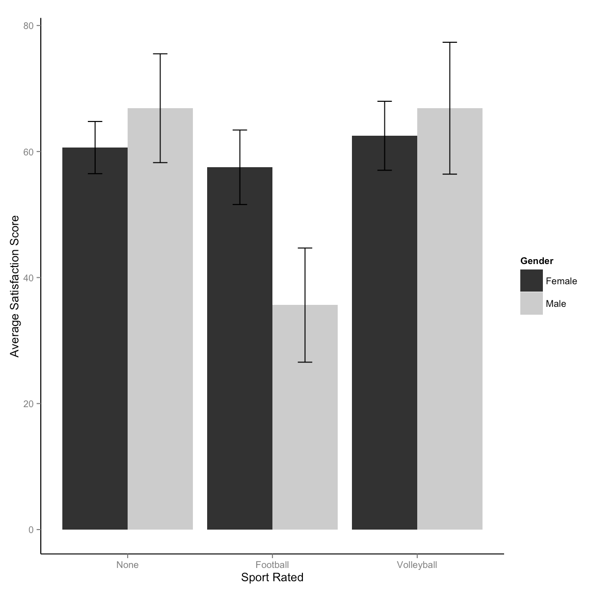

Slide 34
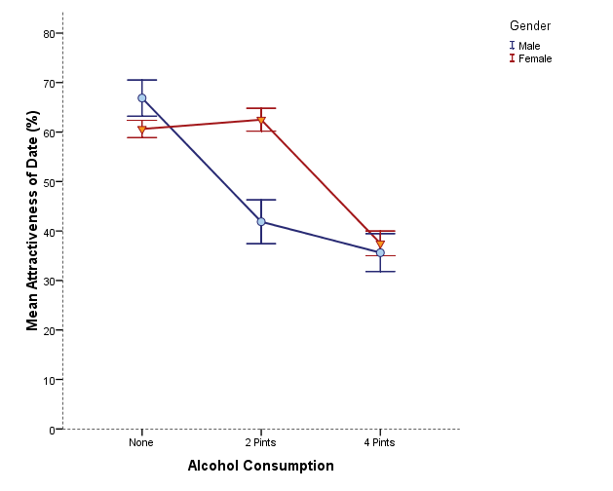
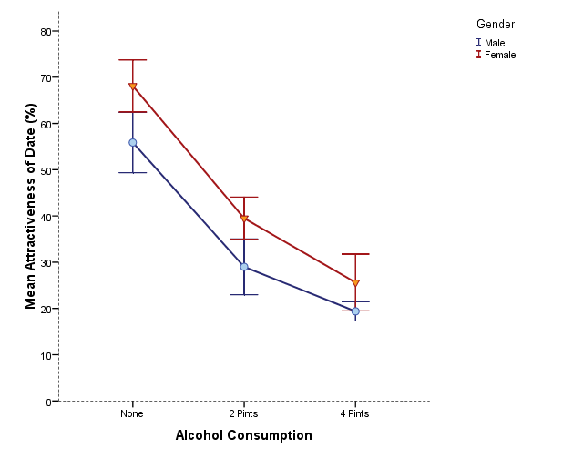
Is there likely to be a significant interaction effect?
Yes
No

Slide 35
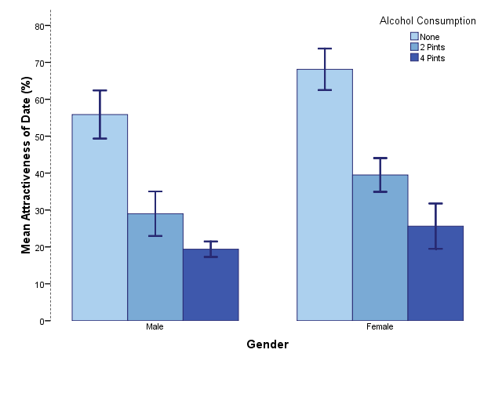
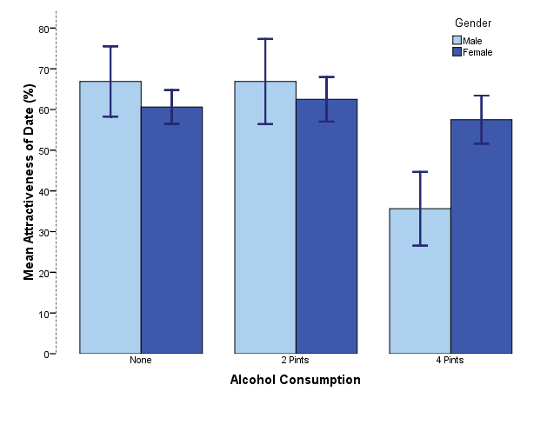
Is there likely to be a significant interaction effect?
No
Yes

Slide 36
A effect only

Slide 37
B effect only

Slide 38
Perfect Interaction

Slide 39
All Effects

Slide 40
None

Slide 41
Interpreting graphs
Flat lines = no effect
Parallel lines = no interaction
Un-separated lines = no effect

Slide 42
Interaction = What Now?
Simple effects analysis
A concern:
Type 1 error rate
Back to familywise vs experimentwise

Slide 43
Interaction = What Now?
Suggestions:
A lot of people will not run the MAIN EFFECTS post hoc analyses (the ones you can get automatically) when the interaction is significant
Because the conditions matter … so why only look at the levels?
However, sometimes people still run the main effects post hocs for smaller designs.

Slide 44
How to run R
IMPORTANT:
You do NOT run post hocs on MAIN EFFECTS that only have two levels. You just look at the means to compare them.
Gender here only has two levels – so we would just look at the means.

Slide 45
Main Effects
Gender
Women (M = 60.21, SD = 6.34) rated sports overall the same as Men (M = 56.46, SD = 18.50)
Sport
Use a post hoc like the last chapter.

Slide 46
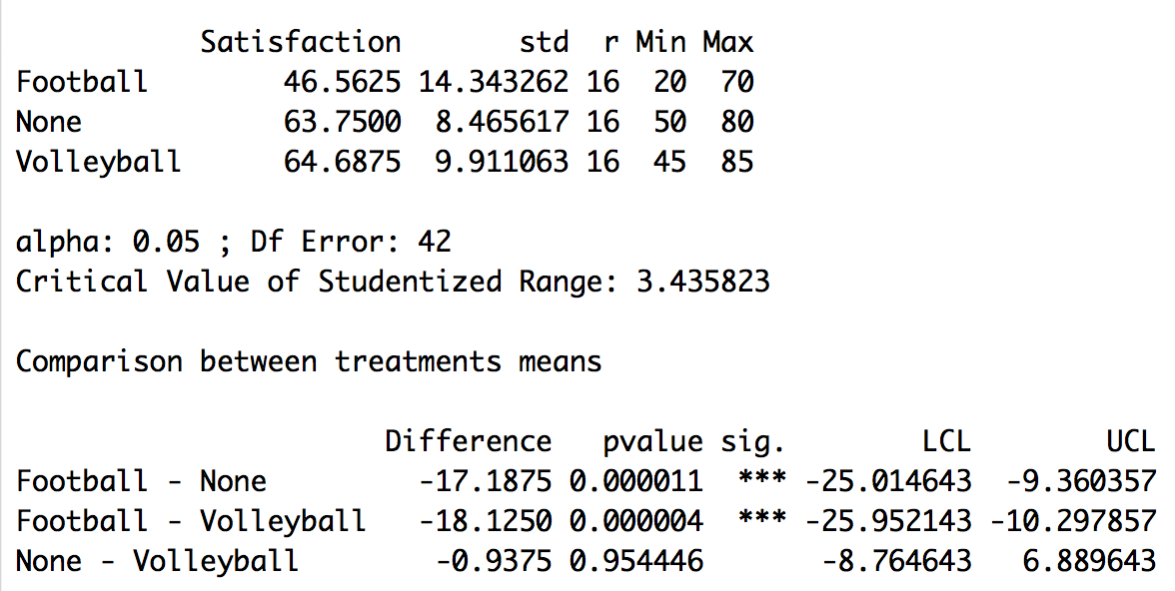
Main Effects
For sport, we can use the Agricolae library again.

Slide 47
Interaction = What Now?
How to run a simple effects analysis:
Go across OR down, but not both.
Pick the direction with the smaller number of levels.
(or stick with your hypothesis).

Slide 48
Interaction
We are doing a between subjects ANOVA
Therefore, we want to follow up with independent t-tests.
Type 1 Error Correction
How can we control for our error?

Slide 49
Interaction
We can’t use the agricolae library directly, but we can coerce it into doing the post hoc for us.
Split up the dataset by the larger number of levels:
Remember the subset function:
Data = subset(dataset, rule)

Slide 50
Interaction
Run ANOVAs for each of those subgroups and save their output.
Then run the post hocs with the agriculture library.
Remember the the IV name in that should NOT be the one you split on.

Slide 51
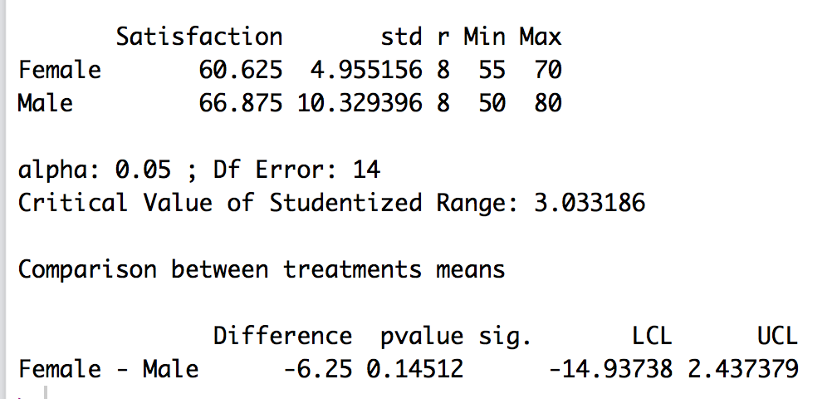
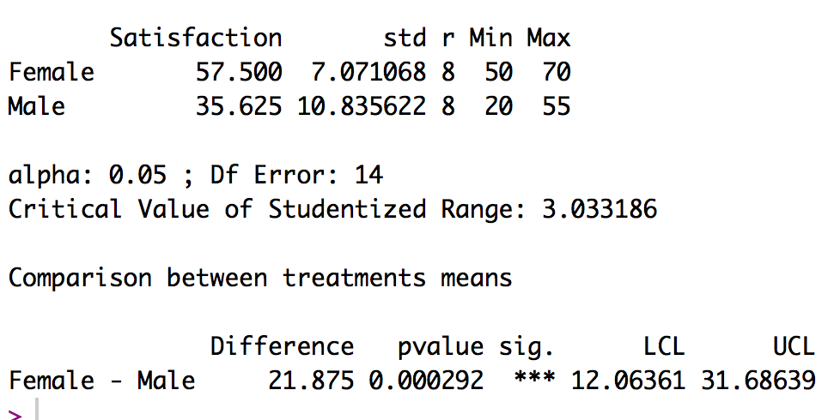
None
Football

Slide 52
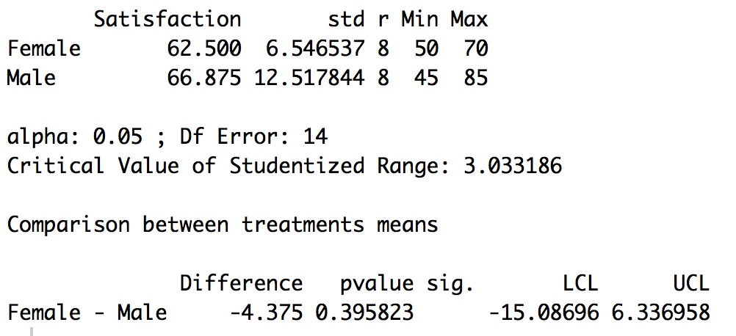
Volleyball

Slide 53
Effect sizes
Cohen’s d (hedges g) for each post hoc test, since you are comparing two groups means at a time.

Slide 54
Example write ups
Are in the book, but should include:
Omnibus test for IV1
Omnibus test for IV2
Omnibus test for Interaction
Any post hoc tests.

Slide 55
Example write ups
Some people structure like this:
IV1 F test → post hoc IV1
IV2 F test → post hoc IV2
Interaction F test → post hoc interaction
Figure
But that doesn’t work if you don’t want to do the post hocs because of the interaction
IV1 F, IV2 F, Interaction F
Post hoc tests
Figure

